Slide 1
Non-Alcoholic fatty liver disease and vascular endothelial stem cell imaging
Pradipta Mukherjee
Computational Optics Group, University of Tsukuba

Slide 2
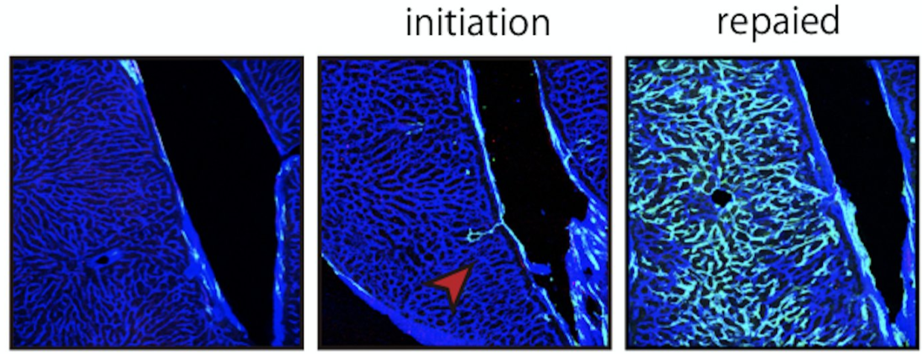
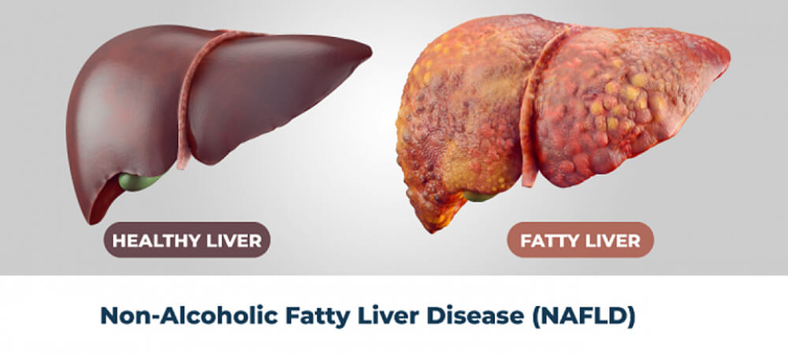
Outline
Non-Alcoholic Fatty Liver Disease
Vascular Endothelial Stem cell
Hepatic Steatosis and Steatohepatitis
Regenerative Medicine

Slide 3
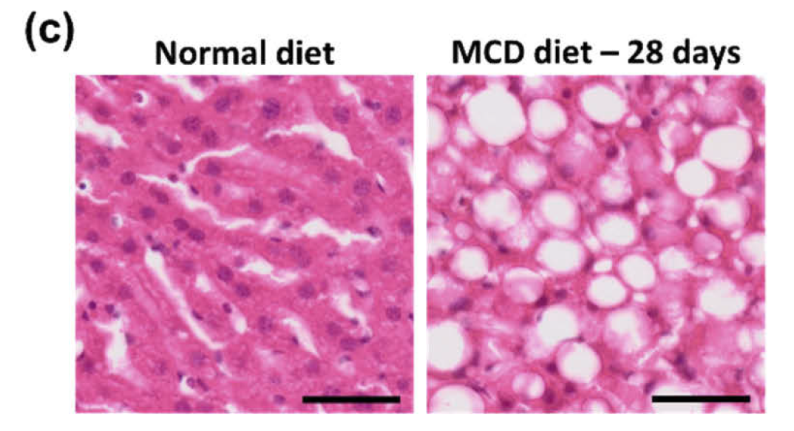
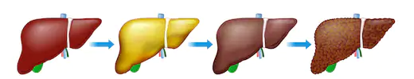
Hepatic Steatosis and Steatohepatitis
Healthy liver
Fatty liver
Fibrosis
Cirrhosis / Liver cancer
J. Moon, J. Moon, E. Kong, E. Kong, J. Lee, J. Lee, J. Jung, E. Kim, S. B. Park, S. B. Park, P. Kim, P. Kim, and P. Kim, Biomed. Opt. Express, 11, 5132–5146 (2020).

Slide 4
Lipid droplet
Lipid droplets (LDs), a monolayer enclosing phospholipid and associated proteins, are main lipid-storing subcellular organelles in most cell types.
Recent studies suggest that LDs exhibit highly dynamic three-dimensional(3-D) motions inside cells to regulate intracellular lipid storage and provide a lipid source for energy metabolism.
In addition to their roles in lipid storage and metabolism, LDs are related with various pathologies, including cancer, obesity, and diabetes mellitus.
K. Kim, S. Lee, J. Yoon, J. Heo, C. Choi, and Y. Park, "Three-dimensional label-free imaging and quantification of lipid droplets in live hepatocytes," Scientific Reports 6, 36815 (2016).

Slide 5
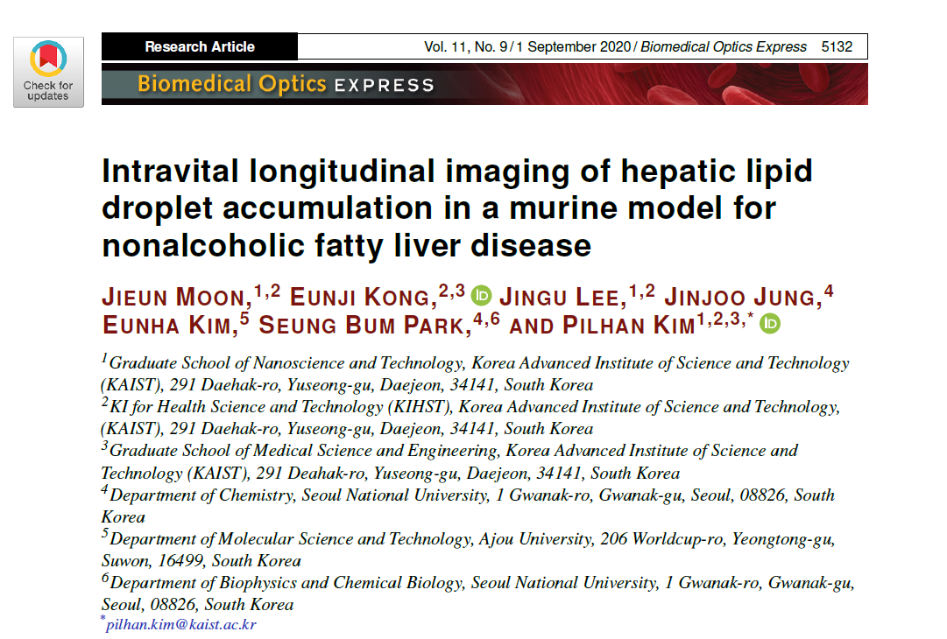
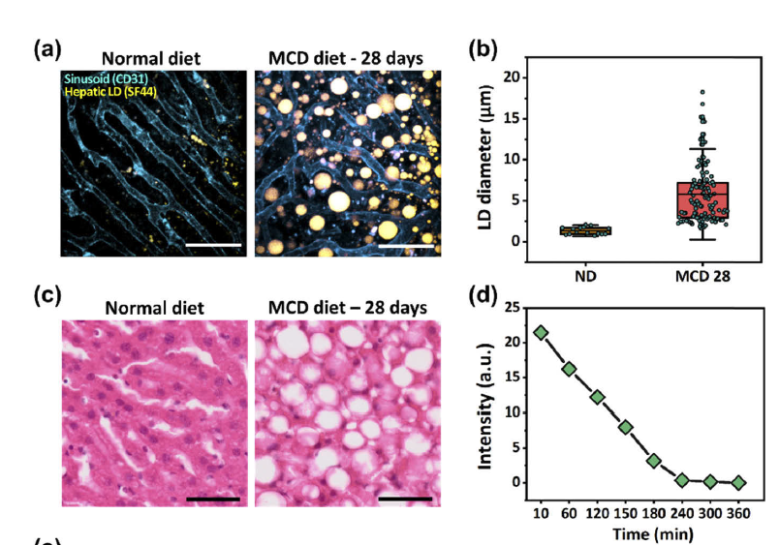
Lipid droplet imaging

Slide 6
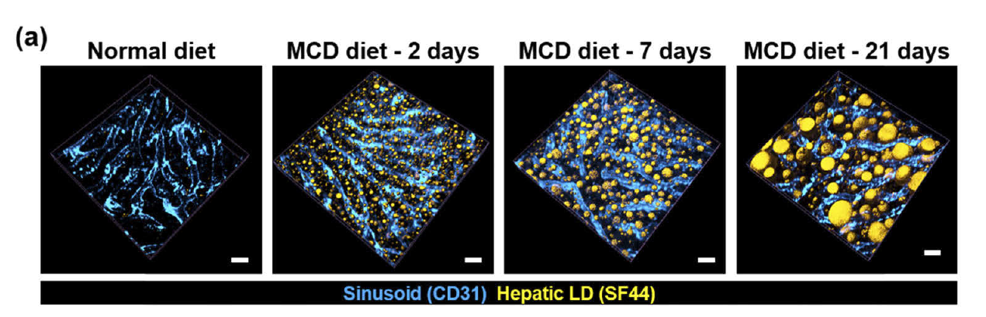
Fluorescence imaging
Simultaneous imaging of liver vasculature and lipid droplet
Novel fluorescent lipid droplet labeling dye, Seoul-Fluor 44 (SF44) has been used.
Mouse model
To induce nonalcoholic steatosis and steatohepatitis, mice were fed with a methionine and choline-deficient (MCD) diet (Envigo, USA).
J. Moon et al., Biomed. Opt. Express, BOE 11, 5132–5146 (2020).

Slide 7
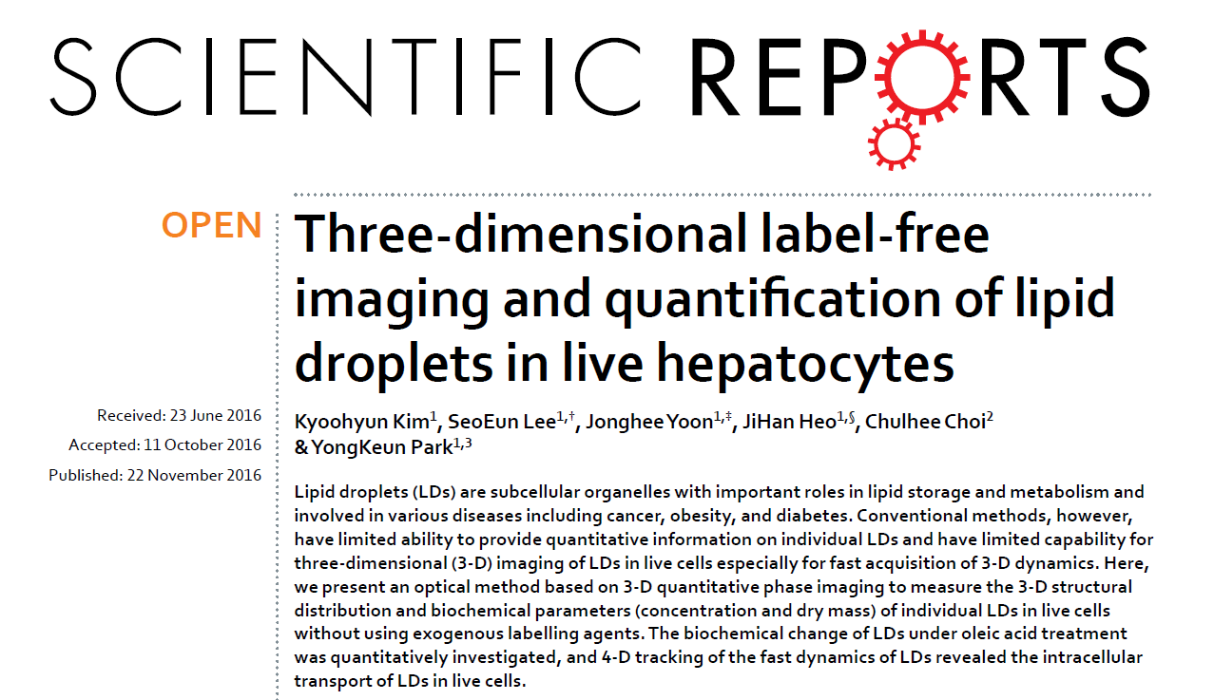
label-free 3-D imaging of LDs
Sample used in this study
Human hepatocytes (human hepatocellular carcinoma cell line, Huh-7, Apath, Brooklyn, NY, USA) were used.

Slide 8
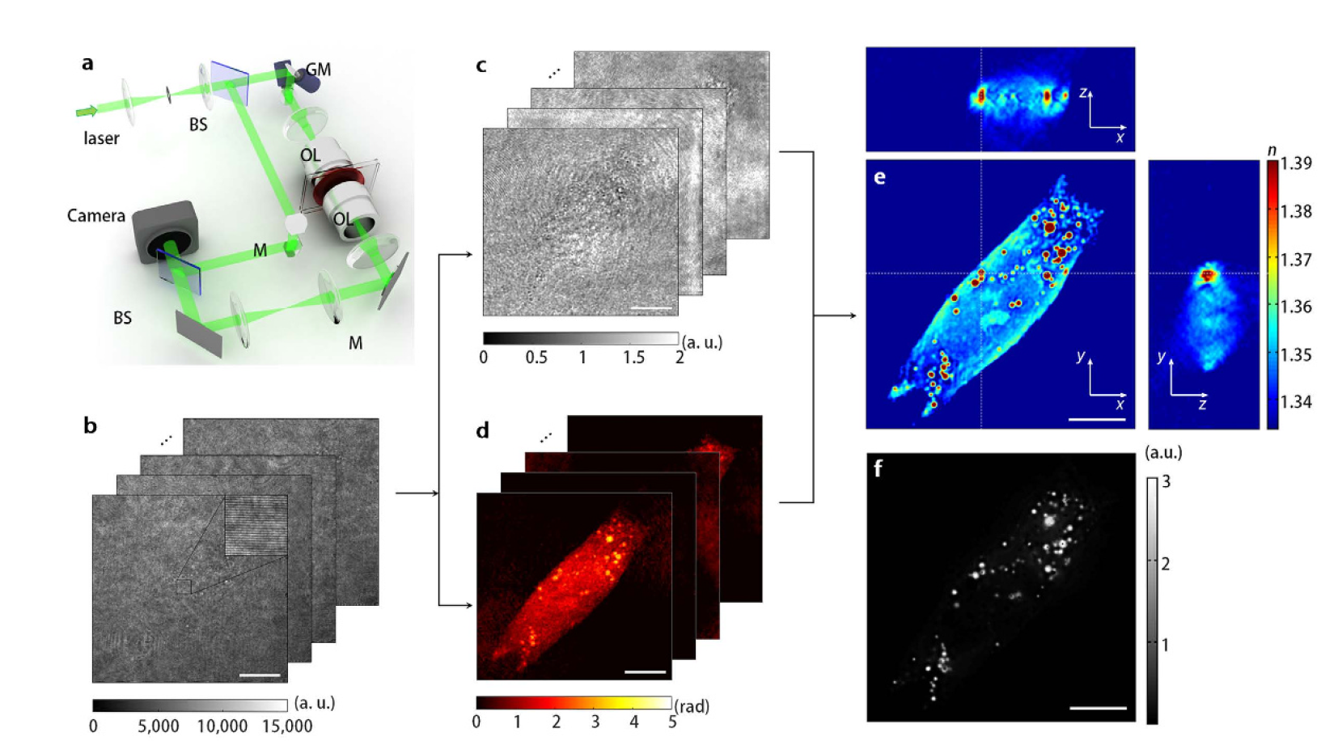
label-free 3-D imaging of LDs
Optical diffraction tomography
Amplitude
3D RI distribution
Measured holograms of a hepatocyte (Huh-7) at different incident angles
Phase
fluorescence
image of LDs stained with Nile Red
K. Kim, S. Lee, J. Yoon, J. Heo, C. Choi, and Y. Park, "Three-dimensional label-free imaging and quantification of lipid droplets in live hepatocytes," Scientific Reports 6, 36815 (2016).

Slide 9
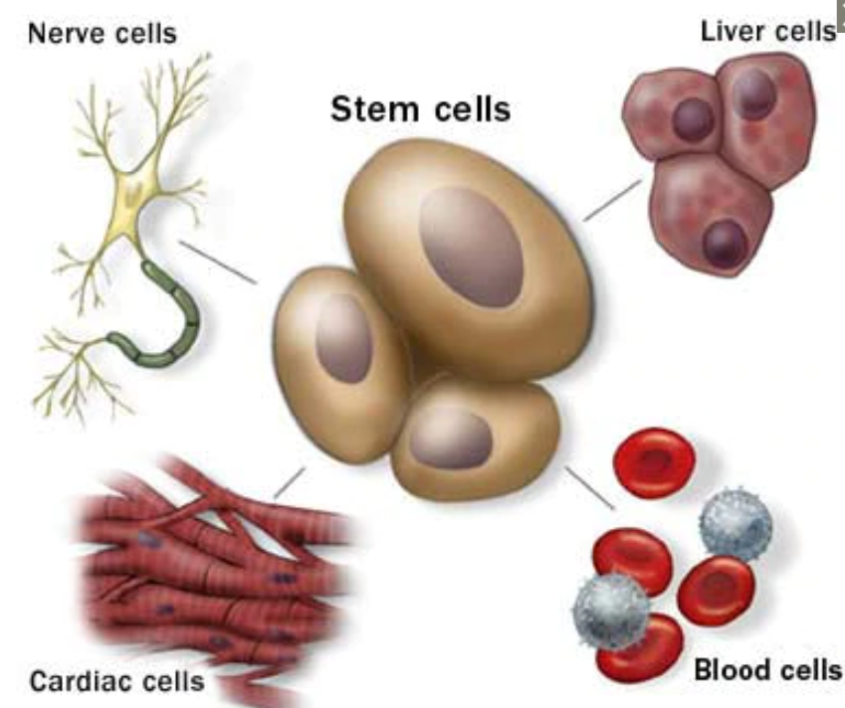
Stem cells: What they are and what they do?
Stem cells
The body's master cells
Stem cells are the body's raw materials from which all other cells with specialized functions are generated.
Under the right conditions in the body or a laboratory, stem cells divide to form more cells called daughter cells.
These daughter cells either become new stem cells (self-renewal) or become specialized cells (differentiation) with a more specific function, such as blood cells, brain cells, heart muscle cells or bone cells.
No other cell in the body has the natural ability to generate new cell types.
https://www.mayoclinic.org/tests-procedures/bone-marrow-transplant/in-depth/stem-cells/art-20048117#:~:text=Researchers%20have%20discovered%20stem%20cells,developing%20fetus%20in%20the%20uterus.

Slide 10
Why such an interest in stem cells?
Increase understanding of how diseases occur.
Regenerative medicine
Specific cells that can be used to regenerate and repair diseased or damaged tissues in people.
Stem cells may have the potential to be grown to become new tissue for use in transplant and regenerative medicine.
Drug development
Researchers can use some types of stem cells to test the new drugs for safety and effectiveness before using investigational drugs in people.

Slide 11
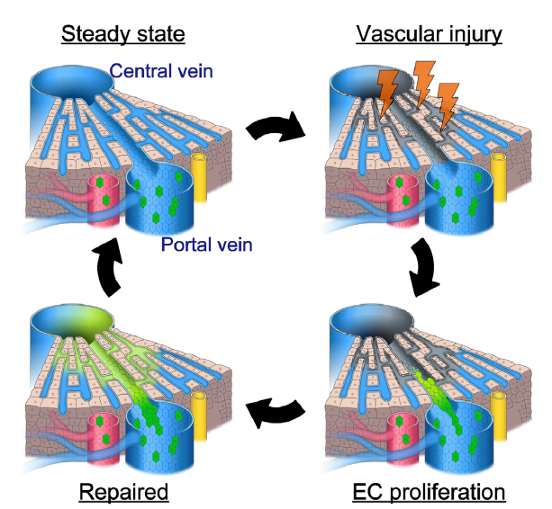
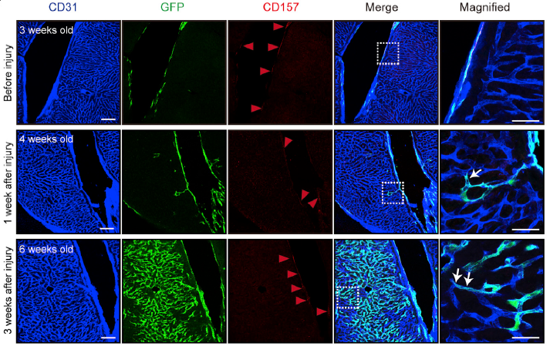
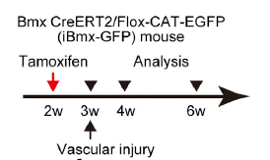
Vascular regeneration in mouse liver
Taku Wakabayashi et al. “CD157 Marks Tissue-Resident Endothelial Stem Cells with Homeostatic and Regenerative Properties”, Cell Stem Cell (2018).

Slide 12
Current method and their drawbacks
Fluorescence microscopy
Coherent anti-Stokes Raman scattering (CARS) microscopy
Drawback:
Advantage:
label-free imaging
Staining LDs with various fluorescent probes
Drawback:
Complicated and bulky optical components for nonlinear optical processes
may perturb the physiological conditions of the LDs due to phototoxicity and photobleaching
Common Drawback:
Axial stacking for 3-D LD imaging, which limits the real-time investigation of fast 3-D dynamics of LDs inside cells.

